Slide 1
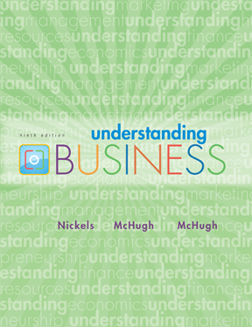
*
Chapter Thirteen
*
Marketing: Helping Buyers Buy
McGraw-Hill/Irwin
Copyright © 2010 by The McGraw-Hill Companies, Inc. All rights reserved.
Notes:
1

Slide 2
Learning Outcomes
By the end of this session, students will be able to:
Define what is marketing
Evolution of marketing
differentiate consumer and business market
explain how the marketers apply the tools of market segmentation
compare the business-to-business market and the consumer market

Slide 3
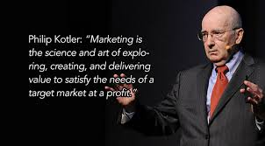

Slide 4
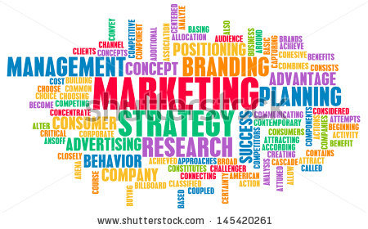
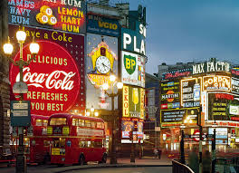

WHAT’S MARKETING?
*
What is Marketing?
*
LG1
Marketing -- The activity, set of institutions and processes for creating, communicating, delivering, and exchanging offerings with value for customers, clients, partners and society at large.
13-4

Slide 5
The Evolution of Marketing
The Production Era-more production and less expensive distribution and storage
The Product Era-This era brought about marketing beliefs that consumers will favor those products that offer the most quality, performance or innovative features. Marketing managers focus on making superior products and improving them over time.
The Selling Era -selling and advertising to persuade consumers
The Marketing Concept Era- customer orientation, service orientation, profit orientation
The Societal Marketing Era emphasizes on social responsibilities and suggests that to sustain long-term success, the company should develop a marketing strategy to provide value to the customers to maintain and improve both the customers and society’s well being better than the competitors.

Slide 6
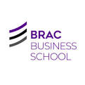


Two different Markets
*
Chapter Thirteen
*
A market consists of people with unsatisfied wants & needs who have the resources and the willingness to buy. 2 major markets in business are:
Consumer Market -- All the individuals or households that want goods and services for personal use and have the resources to buy them.
Business-to-Business (B2B) -- Individuals and organizations that buy goods and services to use in production or to sell, rent or supply to others.
McGraw-Hill/Irwin
Copyright © 2010 by The McGraw-Hill Companies, Inc. All rights reserved.

Slide 7
MARKETING to CONSUMERS
*
The Consumer Market
*
LG5
The size and diversity of the consumer market forces marketers to decide which groups they want to serve.
Market Segmentation -- Divides the total market into groups with similar characteristics.
Target Marketing -- Selecting which segments an organization can serve profitably.
Differentiation and Positioning- creating a distinct space in consumer’s mind
13-7
Notes:
See Learning Goal 5: Explain how marketers apply the tools of market segmentation, relationship marketing, and the study of consumer behavior.

Slide 8
Types of Segmentation
-Geographic
-Demographic
-Behavioral (benefit, occasion and volume)
-Psychographic

Slide 9
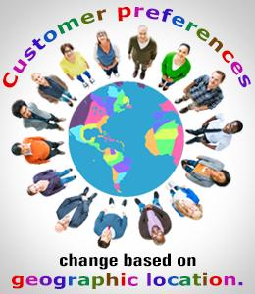
Market Segmentation
Segmenting Consumer Markets
Geographic segmentation divides the market into different geographical units such as nations, regions, states, counties, or cities

Slide 10
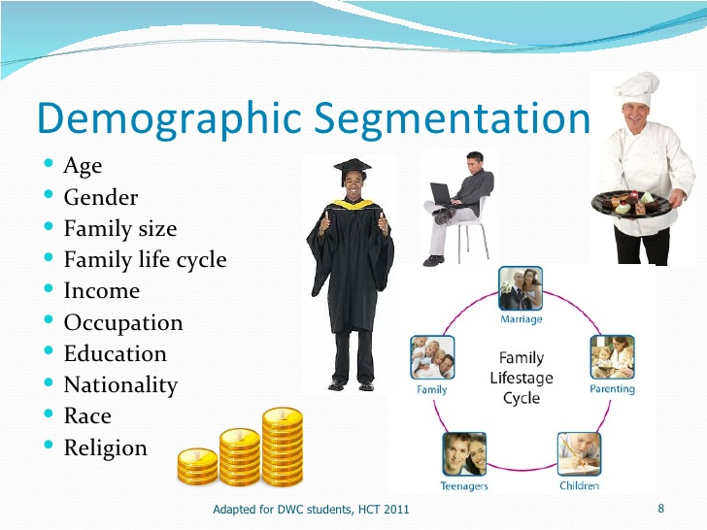
Market Segmentation
Segmenting Consumer Markets

Slide 11
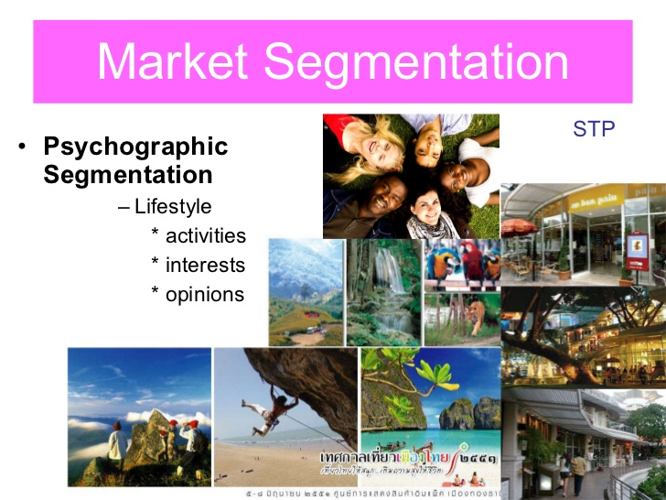
Market Segmentation
Segmenting Consumer Markets
Psychographic segmentation divides buyers into different groups based on social class, lifestyle, or personality traits
Notes:
Note to Instructor
There are a whole group of products which are targeted to the affluent including hotels like Four Seasons, which is mentioned in the book. Their products offerings are deluxe:
Kids in the City package for $520 a night and, among other things, enjoy a visit in their room from the Ice Cream Man, who arrives with all the fixings to make any concoction they desire.
The Benjamin Hotel in New York City provides dog beds in a variety of styles and doggie bathrobes, as well as canine room service and DVDs for dogs.
At the Ritz-Carlton, Lake Las Vegas in Henderson, Nevada, the Love at Lake Las Vegas weekend package includes two nights in the 2,400 square foot presidential suite, helicopter and gondola rides, a champagne-tasting party on a yacht complete with rose petals strewn about and a string trio, use of a luxury car throughout the stay, in-room couples spa treatment, a $5,000 casino line of credit, a $50,000 shopping spree at Neiman Marcus, 14 dozen roses, and a butler-drawn Cristal champagne bath.

Slide 12
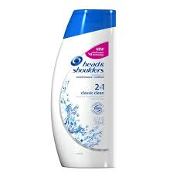

SEGMENTING the CONSUMER MARKET (continued)
*
*
LG5
Benefit Segmentation -- Dividing the market according to product benefits the customer prefers.
13-12
Notes:
See Learning Goal 5: Explain how marketers apply the tools of market segmentation, relationship marketing, and the study of consumer behavior.

Slide 13

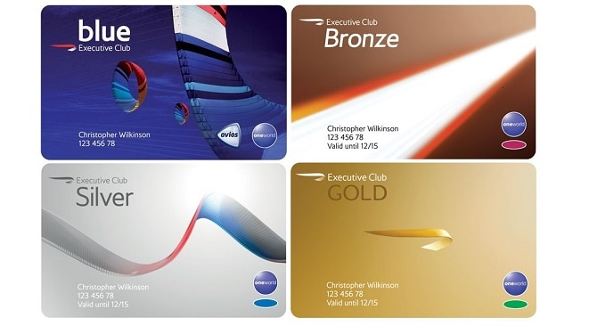
SEGMENTING the CONSUMER MARKET (continued)
*
Segmenting the Consumer Market
*
LG5
Volume (Usage) Segmentation -- Dividing the market by the volume of product use.
User status
Usage rate
Loyalty status
13-13
Notes:
See Learning Goal 5: Explain how marketers apply the tools of market segmentation, relationship marketing, and the study of consumer behavior.

Slide 14

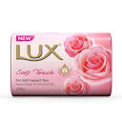


MINI ACTIVITY 1
Identify the segmentation variable being used for the products:

Slide 15
Types of target marketing
Mass
Differentiated
Niche
One to one (local and individual marketing)

Slide 16
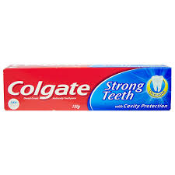
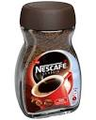
MASS MARKETING
*
Moving Toward Relationship Marketing
*
LG5
Mass Marketing -- Developing products and promotions to please large groups of people.
13-16
Notes:
See Learning Goal 5: Explain how marketers apply the tools of market segmentation, relationship marketing, and the study of consumer behavior.
Mass marketing uses little market segmentation. The goal of relationship marketing is to keep customers happy by offering products that meet exact expectations

Slide 17
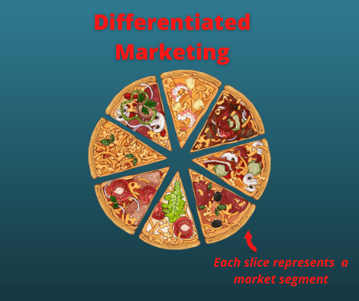
Differentiated marketing targets several different market segments and designs tailored marketing campaigns for each
Goal is to achieve higher sales and stronger position
More expensive than undifferentiated marketing

Slide 18
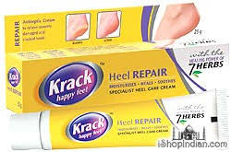
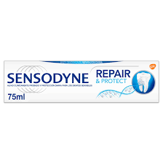
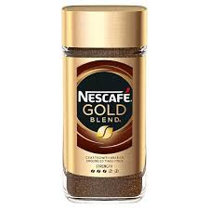
MARKETING to SMALL SEGMENTS
*
Reaching Smaller Market Segments
*
LG5
Niche Marketing -- Identifies small but profitable market segments and designs or finds products for them.
13-18
Notes:
See Learning Goal 5: Explain how marketers apply the tools of market segmentation, relationship marketing, and the study of consumer behavior.

Slide 19
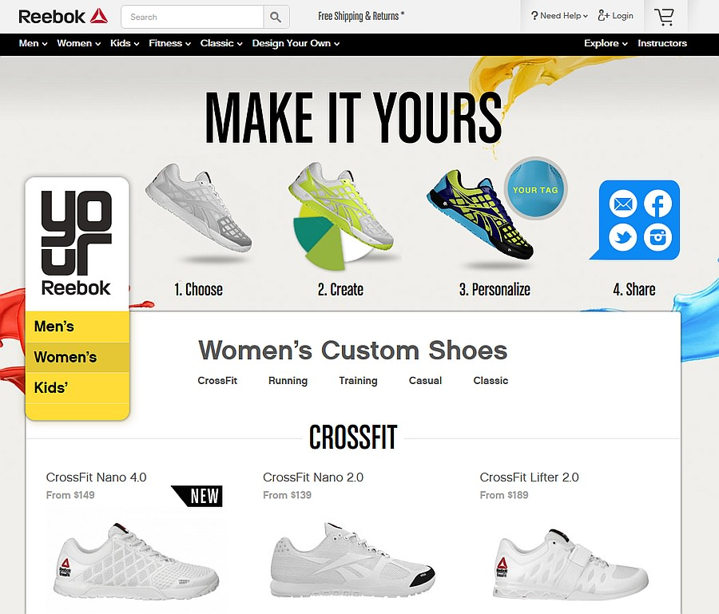
MARKETING to SMALL SEGMENTS
*
Reaching Smaller Market Segments
*
LG5
One-to-One Marketing-- Developing a unique mix of goods and services for each individual consumer.
13-19
Notes:
See Learning Goal 5: Explain how marketers apply the tools of market segmentation, relationship marketing, and the study of consumer behavior.

Slide 20
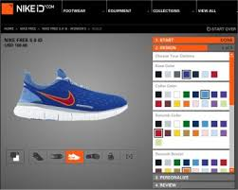
MARKETING to SMALL SEGMENTS
*
Reaching Smaller Market Segments
*
LG5
One-to-One Marketing-
13-20
Notes:
See Learning Goal 5: Explain how marketers apply the tools of market segmentation, relationship marketing, and the study of consumer behavior.

Slide 21
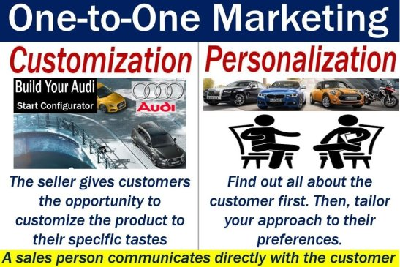
MARKETING to SMALL SEGMENTS
*
Reaching Smaller Market Segments
*
LG5
One-to-One Marketing--
Source: https://marketbusinessnews.com/financial-glossary/one-to-one-marketing-definition-meaning/
13-21
Notes:
See Learning Goal 5: Explain how marketers apply the tools of market segmentation, relationship marketing, and the study of consumer behavior.

Slide 22
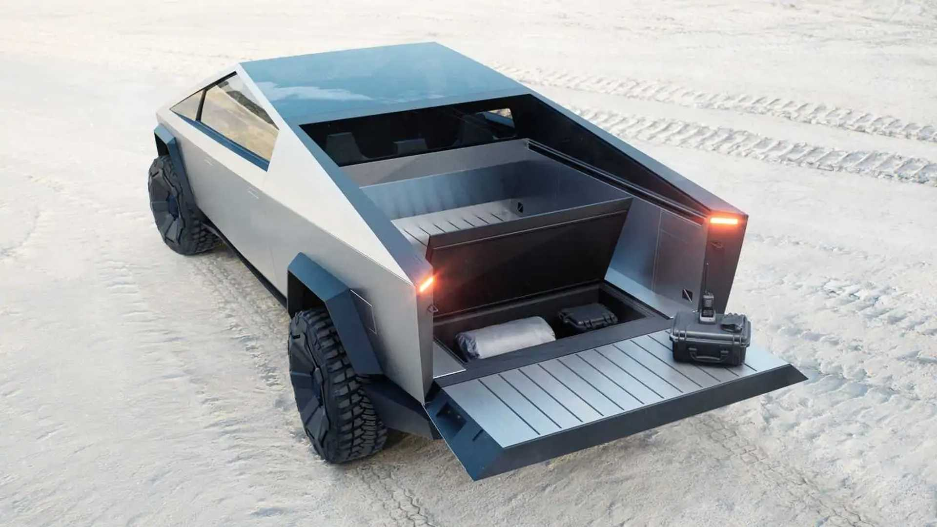

Differentiation & Positioning
Product position is the way the product is defined by consumers on important attributes—the place the product occupies in consumers’ minds relative to competing products
Perceptions
Impressions
Feelings

Slide 23
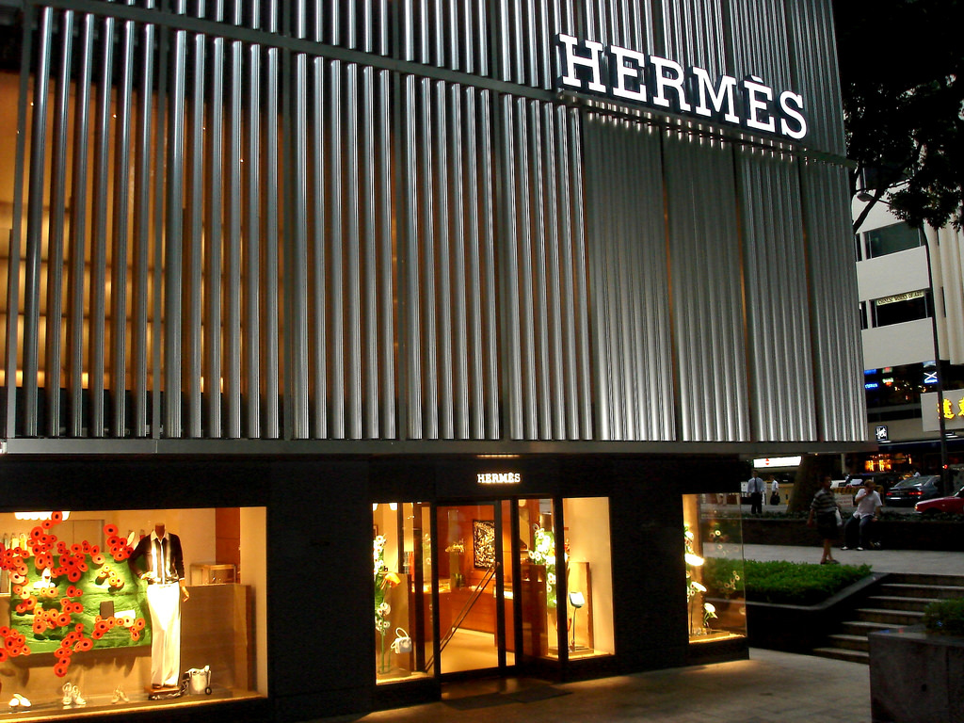
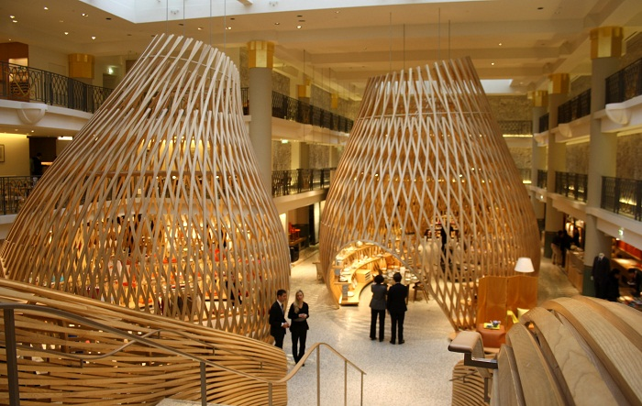
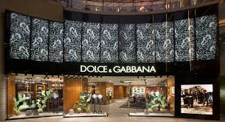
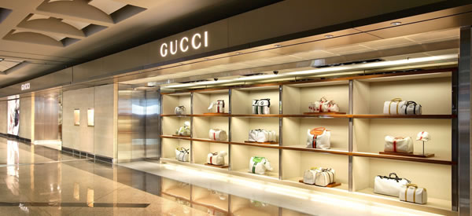

Slide 24
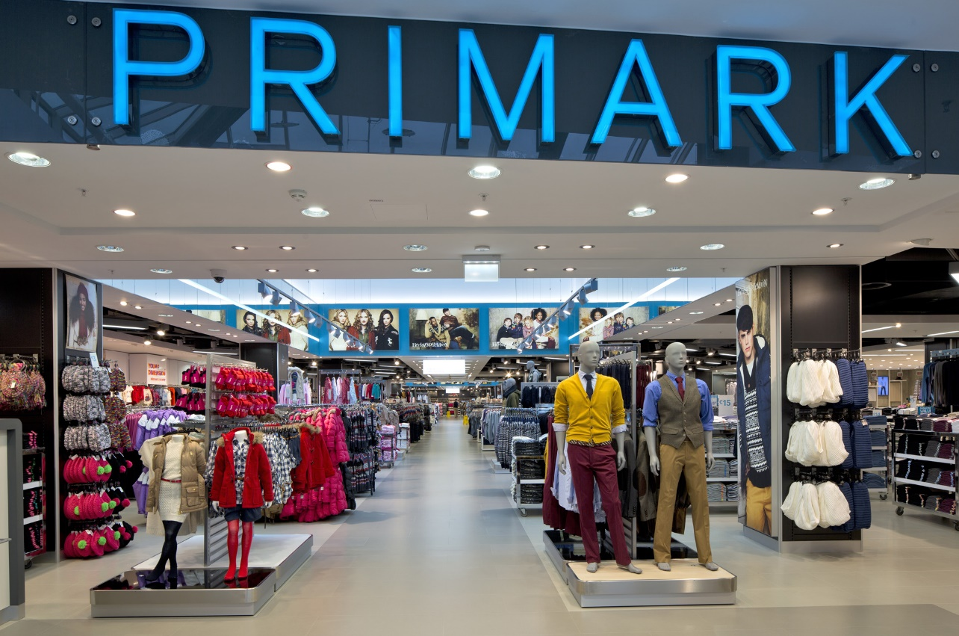
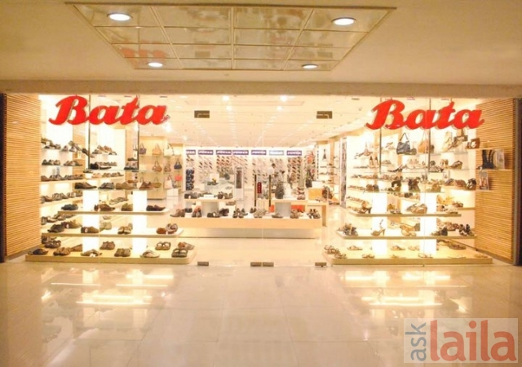
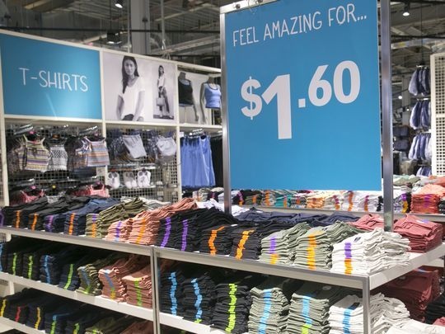

Slide 25
Identifying Possible Value Differences and Competitive Advantages
Competitive advantage is an advantage over competitors gained by offering consumers greater value, either through lower prices or by providing more benefits that justify higher prices

Slide 26
DEVELOPING a PRODUCT
*
Designing a Product to Meet Consumer Needs
Product -- A good, service, or idea that satisfies a consumer’s want or need.
Price -- consider the costs of producing, distributing and promoting the product, which all influence the price.
Promotion -- advertising, personal selling; public relations, publicity; word of mouth and various sales promotion efforts.
Place -- Getting the product to consumers when and where they want is critical to market success
Brand Name -- A word, letter, or a group of words or letters that differentiates one seller’s goods from a competitor’s.
*
LG2
13-26

Slide 27

STEPS in the CONSUMER DECISION-MAKING PROCESS
*
The Consumer Decision-Making Process
*
LG5
Problem recognition
Search for information
Evaluating alternatives
Purchase decision
Postpurchase evaluation
13-27
Notes:
See Learning Goal 5: Explain how marketers apply the tools of market segmentation, relationship marketing, and the study of consumer behavior.

Slide 28
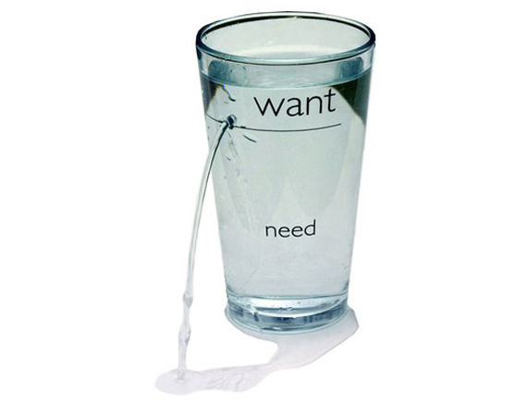
Need Recognition
The buying process starts with need recognition ─ the buyer recognizes a problem or need.
The need can be triggered by internal stimuli when one of the person’s normal needs ─ for example, hunger or thirst ─ rises to a level high enough to become a drive.
A need can also be triggered by external stimuli.

Slide 29

Information Search
Information search is the stage of the buyer decision process in which the consumer is motivated to search for more information.
Traditionally, consumers have received the most information about a product from commercial sources that controlled by the marketer.
The most effective sources tend to be personal.
Commercial sources normally inform the buyer, but personal sources legitimize or evaluate products for the buyer.

Slide 30

Evaluation of Alternatives
The alternative evaluation is the stage of the buyer decision process in which the consumer uses information to evaluate alternative brands in the choice set.
Marketers should study buyers to find out how they actually evaluate brand alternatives.

Slide 31
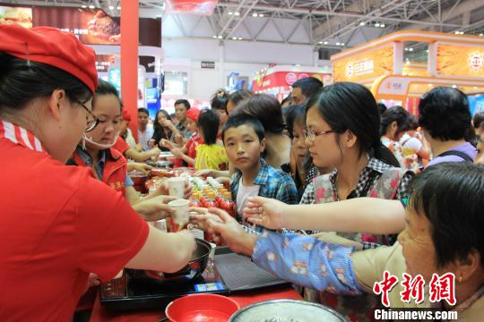
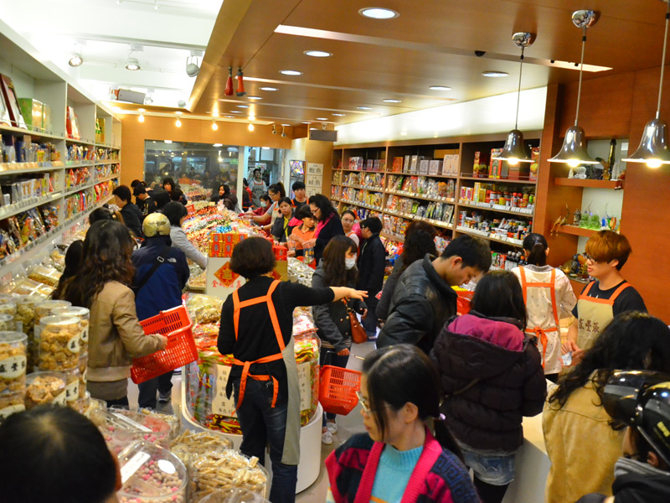
Purchase Decision
The purchase decision is the buyer’s decision about which brand to purchase.
But two factors can come between the purchase intention and the purchase decision.
The first factor is the attitudes of others.
The second factor is unexpected situational factors.

Slide 32

Post purchase Behavior
The post purchase behavior is the stage of the buyer decision process in which consumers take further action after purchase, based on their satisfaction or dissatisfaction.
Almost all major purchases, however, result in cognitive dissonance, or discomfort caused by post purchase conflict.

Slide 33
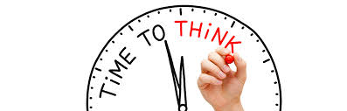
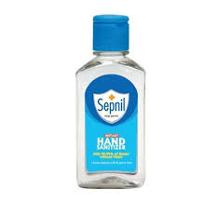
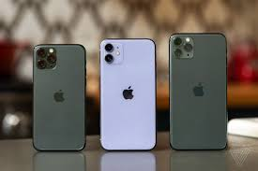
MINI ACTIVITY 2
Apply the CONSUMER DECISION MAKING PROCESS on the mentioned brands and explain.

Slide 34
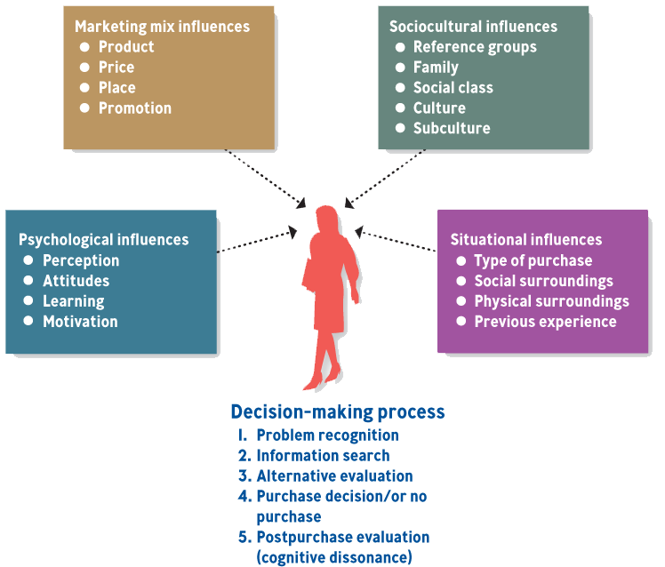
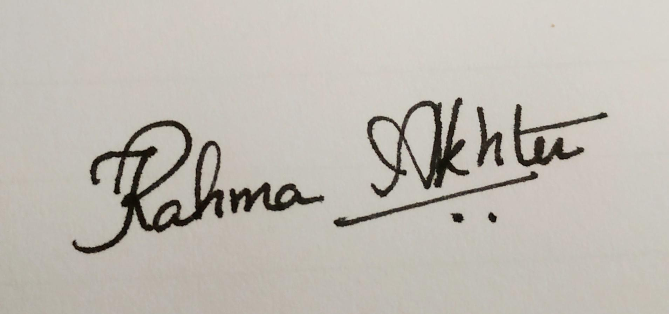
CONSUMER DECISION MAKING PROCESS AND OUTSIDE INFLUENCES
*
The Consumer Decision-Making Process
*
LG5
13-34
Notes:
See Learning Goal 5: Explain how marketers apply the tools of market segmentation, relationship marketing, and the study of consumer behavior.

Slide 35
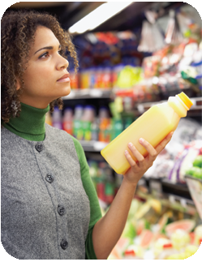
KEY FACTORS in CONSUMER DECISION-MAKING
*
The Business-to-Business Market
*
LG6
Learning
Reference Groups
Culture
Subcultures
13-35
Notes:
See Learning Goal 6: Compare the business-to-business market and the consumer market.
Learning - Creates changes in consumer behavior through experiences and information.
Reference groups - Reference points in forming beliefs, attitudes, values or behaviors.
Culture - The set of values, attitudes and ways of doing things passed from generations.
Subculture - Values, attitudes and ways of doing things from belonging to a certain group.
Cognitive dissonance - Psychological conflict that may occur after a purchase.

Slide 36
Emerging Technologies in Business

Slide 37
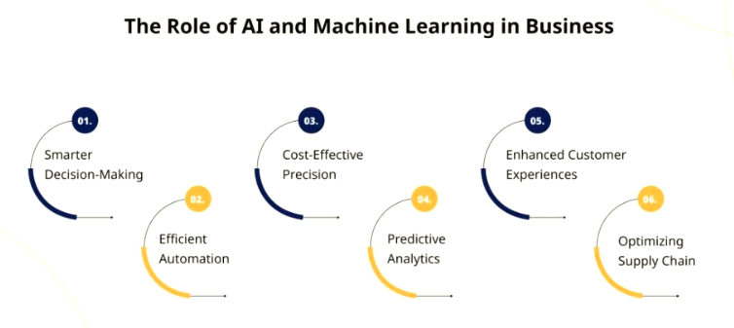
Artificial Intelligence (AI) & Machine Learning (ML)
Applications - Predictive analytics, customer service (chatbots), fraud detection, personalization, supply chain optimization.
Impact: Enhances decision-making, reduces operational costs, and improves customer experience.

Slide 38
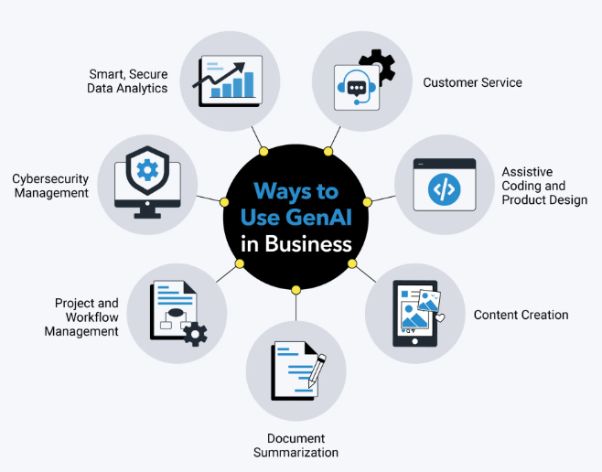
Generative AI
Tools- ChatGPT, DALL·E, Gemini, Claude.
Applications - Content creation, product design, coding assistants, marketing automation.
Impact - Increases productivity and creativity while reducing manual work.

Slide 39
Digital Marketing
Tools- SEO, Social Media Marketing, Email Marketing, Content Marketing, Pay-Per-Click (PPC), Affiliate Marketing
Applications -
Improves website visibility on search engines to attract organic traffic (SEO)
Engages audiences through social platforms to build relationships and promote offerings (Social Media Marketing)
Delivers targeted messages via email to inform, nurture, and convert potential customers (Email Marketing)
Expands reach through partnerships where third parties promote products for a commission
Builds brand visibility, attracts targeted audiences, and converts engagement into measurable business growth

Slide 40
FinTech (Financial Technology)
Tools- Digital banking apps, mobile payment platforms, online investment services, crowdfunding sites, financial planning tools
Applications -
Streamlines financial transactions by enabling fast, cashless payments through mobile devices
Improves access to financial services for underserved populations through user-friendly apps
Supports personal financial management with budgeting, saving, and investment tools
Facilitates alternative financing such as peer-to-peer lending and crowdfunding for individuals and businesses
Simplifies global transactions with lower fees and faster processing for cross-border payments

